Slide 1
Part II
Why? Or how did we get here?

Slide 2




Erlang is Very Open Source
https://en.wikipedia.org/wiki/Erlang_(programming_language)
By 1988 Erlang had proven that it was suitable for prototyping telephone exchanges…
In 1998, C++ and OO patterns was going to save the world and make us all super-human programmers (coders)
In 1998 Ericsson announced the AXD301 switch, containing over a million lines of Erlang and reported to achieve a high availability of nine "9"s.^{[11]} Shortly thereafter, Ericsson Radio Systems banned the in-house use of Erlang for new products, citing a preference for non-proprietary languages.
Java was touted as a safer way to do OO. C++ people hated it and said it would never perform
The implementation was open-sourced at the end of the year.^{[6]} Ericsson eventually lifted the ban and re-hired Armstrong in 2004.^{[12]}
And So Elixir is very Open Source Also
Notes:
What do C++ and Erlang have in common?

Slide 3


Erlang to the people: Elixir
Build a new syntax*
Twist a few rules – names can be reused*
Add a modern package manager (like Gem)
Implement standard libraries very similar to Clojure: Map, Enum.filter
Phoenix (offshoot): A Web Framework - Ecto borrows on Microsoft Linq
Leverage everything in Erlang – 100% interop with Erlang all the time
Notes:
The AST is very very easy
Erlang people hate this
Cowboy is great Erlang’s incredible safe Macros allows Erlang syntax to be changed (AST). Elixir is just and extension and unlike Clojure which introduces new data structures, etc.

Slide 4
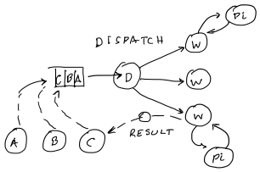
2012 My Introduction to Erlang
Manage a push server
Scale from 50,000 to 4 million
Live connections to mobile phones
And interact with the typical Web Application – stay responsive
EventMachine, non-blocking I/O, callback hell, fragile as heck, restarts?
Erlang was mind-twisting
2016 – hit with similar challenge again – this time I found Elixir

Slide 5
Lots of connections
Threads (or Processes)
Blocking threads, just lots of them (blocking on what)
A thread pool and handover, etc.
Asynchronous I/O
Non-blocking I/O, share a thread and give it up cooperatively

Slide 6
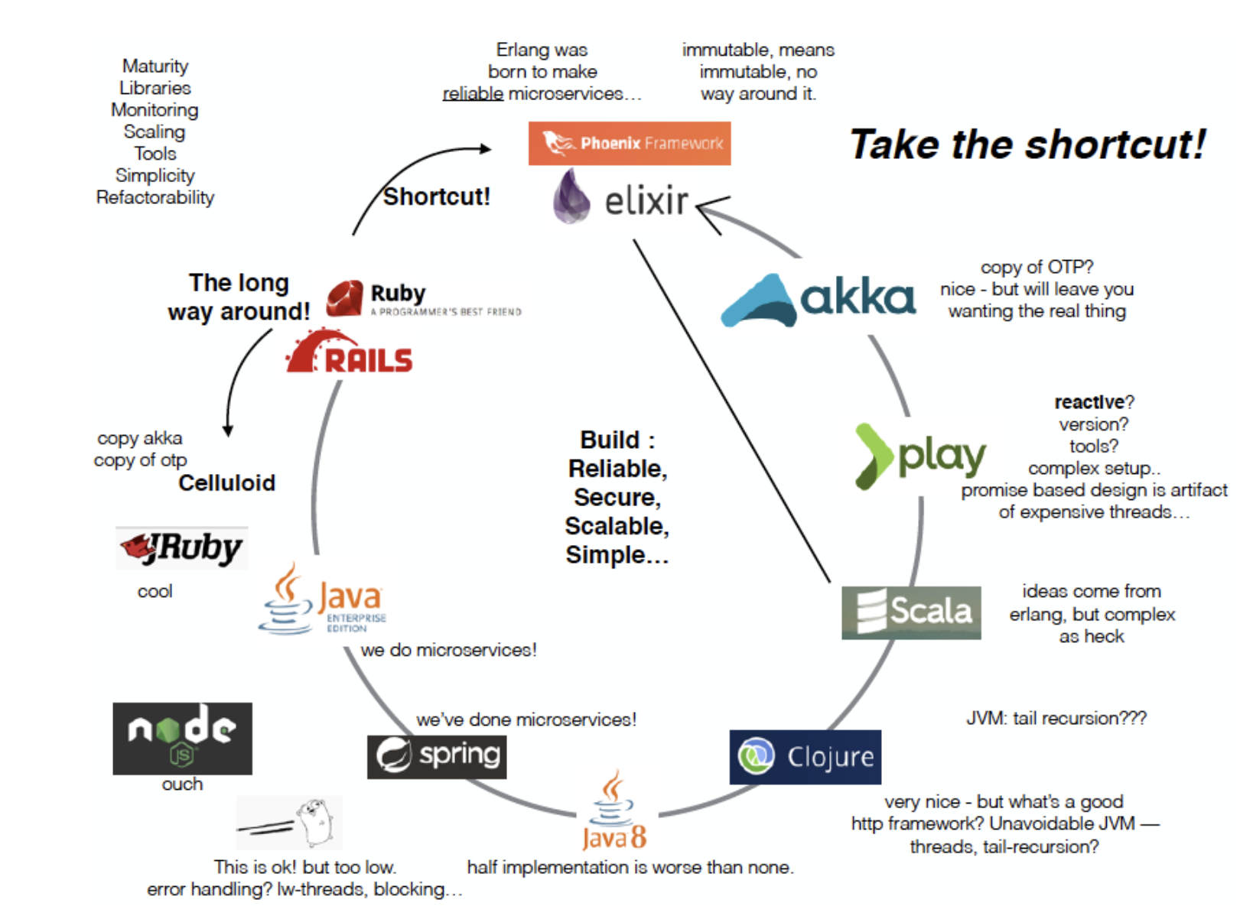

Slide 7
Read it in my Blog (or LinkedIn has more)
Scala/Play and Akka, etc.
Mixes Asynchronous I/O and Threads
Strange results
If you happen to be running on the same thread that starts doing some big operation and stalls the thread
Rails
Take your pick:
non-blocking (Thin),
Threads (Puma),
Forked processes (Unicorn)
Clojure
Tool chain, pmap was deal breaker, community agreement on good web server
Too academic – people wanted to do everything themselves

Slide 8
Microservices
Started with a microservice architecture
Decided microservices where more trouble than they were worth
Promised myself never to _start_ with a microservice architecture
HTTP is a terrible interprocess protocol, GCP is better, Message Queues
Must have x databases to be true microservices
Deploying/upgrading as a package, etc
Good reasons for microservices
Needs to be replaceable by something else, external dependency
Promises were cool, now async await is cool
Microservices were cool, now serverless is cool

Slide 9

https://tomjoro.github.io/2017-01-31-world-changed/

Slide 10


Practical – the world changed
Read my blog: https://tomjoro.github.io/2017-01-31-world-changed/
Shitty programs are the result of bad coders… True/false?
”The principal objection was efficiency; copying messages between processes (instead of using shared memory) was considered horrendously inefficient. ”
multicore

Slide 11
Reliability in the real world
The system would have to be constructed from physically isolated components communicating through well-defined "pure" protocols.
Why did it take Java until 1.8 to get multicore? What are L2 cache misses?
If we use obey this same rule we could run many processes on the same computer but still have the same reliability characteristics
Also, it mean processes could run any any core, or on another computer without any changes.
Notes:
That’s why Java didn’t support multiple cores for a long time.
Of course you can run many processes on each core, but they will not be parallel

Slide 12
Process Scheduler
Elixir – Fair, fully pre-emptive scheduler, per-process garbage collection
Go – Cooperative scheduler, not fair, global garbage collection
Java – Pre-emptive, native threads
Clojure, Scala, Akka,
Akka implements lightweight threads so I can have lots
Ruby - green threads
In Elixir, the whole discussion about concurrency vs parallellism doesn’t make much sense because everything that is concurrent can be parallel by design.

Slide 13
func f1(from string) {
for i := 0; i < 100000; i++ {
fmt.Println(from, ":", i)
}
}
// Try commenting the fmt.Println, what happens?
func f2(from string) {
i := 0
for {
fmt.Println(from, ":", i)
i++
}
}
func main() {
//f1("direct")
go f1("1 goroutine")
go f2("2 goroutine")
go func(msg string) {
fmt.Println(msg)
}("going")
time.Sleep(time.Second * 5)
fmt.Println("done")
}
defmodule Spawn do
def loop1(name, num) do
#IO.puts "#{name} #{num}"
#:timer.sleep(1000)
loop1(name, num + 1)
end
def loop2(name, num) do
IO.puts "#{name} #{num}"
#:timer.sleep(1000)
loop2(name, num + 1 )
end
def init() do
# Spawn.loop("direct", 0)
pid = spawn(Spawn, :loop1, ["loop1", 0])
pid = spawn(Spawn, :loop2, ["loop2", 0])
:timer.sleep(10000)
end
end
Experiments:
Go – comment out the fmt.Println in f2, what happens?
How can you fix with a Go command?

Slide 14


go_race.go
package main
import (
"fmt"
"time"
)
type field struct {
name string
}
func (p *field) print() {
fmt.Println(p.name)
}
func main() {
data := []field{{"one"}, {"two"}, {"three"}}
for _, v := range data {
time.Sleep(time.Second)
go v.print()
}
<-time.After(1 * time.Second)
}
//why does this code print "two" "two" "three"
Go idiom:
Elixir law: You cannot share memory
(prevent idiotic)

Slide 15
Key takeaways
Other languages have better performance (Go, etc.)
Fairness
Means my thing will run
Means it will run consistently
The garbage collector will not ruin my day
I want threads (that are actually processes), and
I want as many as I need, and
I want to do whatever I need to in simple sequential logic
I don’t want to write a scheduler in my code (not cooperative and not to worry about how “expensive” threads are)

Slide 16
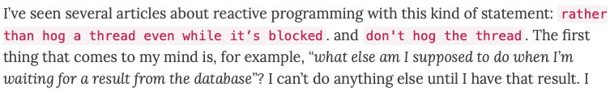
Don’t Hog The Thread
https://tomjoro.github.io/2017-02-03-why-reactive-fp-sucks/
It’s Win 3.1 all over again
It’s my thread, and I’ll do what I want with it! Anything. Crash, use lots of computation power, etc.
In an ideal world I could have as many threads as I wanted, they would be isolated (processes), and I could do what I want with them without having to write scheduling code. I could use libraries that use the same idea without having to inspect their code.
What if a goroutine runs out of memory?

Slide 17
To Kill a Thread
If the system even permits shared memory between threads (or routines) then:
It is impossible to kill them safely
You must stop them to do garbage collection (but you can apply some very intelligent strategies).
https://docs.oracle.com/javase/1.5.0/docs/guide/misc/threadPrimitiveDeprecation.html
There is no way to gracefully kill a thread. Generally you don't kill, stop, or interrupt a thread (or check wheter it is interrupted()), but let it terminate naturally. It is simple. You can use any loop together with (volatile) boolean variable inside run() method to control thread's activity.

Slide 18
Supervisors
Elixir supervisors watch processes and take actions when bad things happen
Go says: you must handle the error locally
Elixir says: don’t handle it locally, because there’s usually no good solution anyways
In Elixir code, you will see very little error handling – in fact, local handling of errors in Elixir is a code smell … <what!?> -- this is beautiful because it means your code is your happy path and not lots of error checks – crashing is the best option.
In Go, almost every function and return has local a error check and a handler because if it leaks the exception everything crashes

Slide 19
Real experience with supervisors
OP Kasvomaksu running Elixir in production
4000 purchases of ice-cream for 0.10e each
Running on a single server with no failover
Terminal had incorrect handling and crashed, brought down the cash register processes. Supervisor picked up the pieces and restarted everything to clean state. We fixed the problem at the end of the day.
We have never had a failure in over a year
Elixir on BEAM is in many ways like an operating system – but built for writing applications

Slide 20
Clojure
Clojure uses native threads
So that means it’s pre-emptive
Is it fair?
Do I have to worry about scheduling and garbage collection?
Clojure is great, but not what JVM was designed for
Tail call optimization is difficult, needs help
Shared memory prevents safely cleaning up a bad thread
Threads are expensive – ‘can I has’ 10,000 of them and do what I want?
Lightweight threads face scheduling problems
Pmap in clojure (next page)

Slide 21
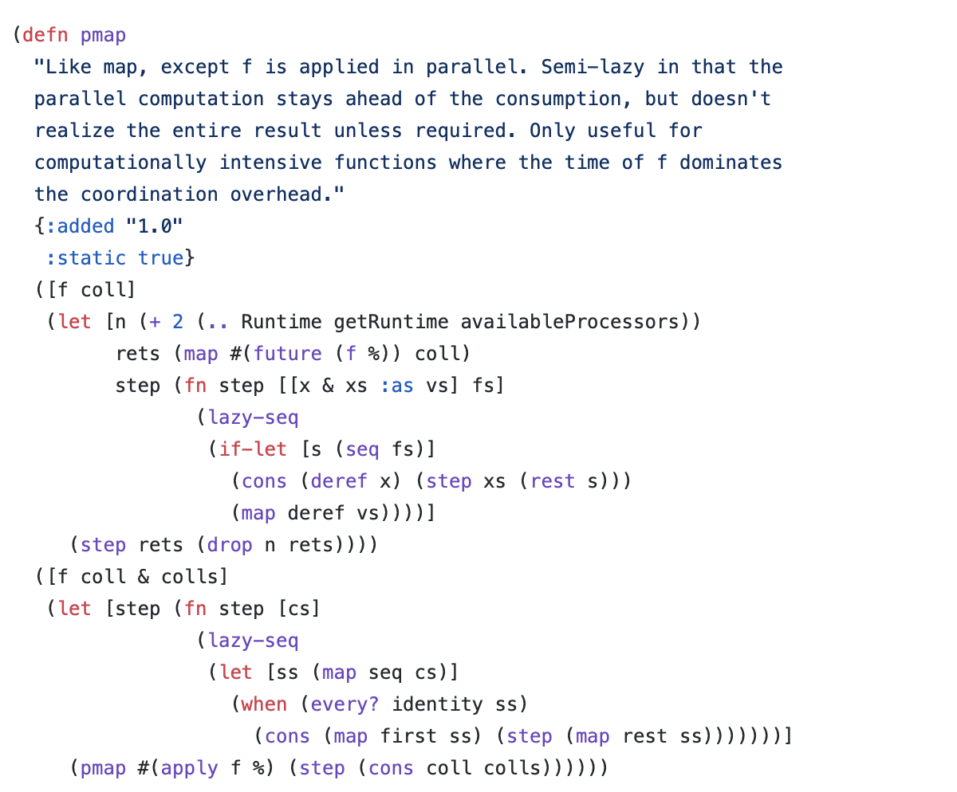

Main point: pmap uses threads and threads are heavy
https://www.bradcypert.com/understanding-clojures-map-pmap/
isn’t a good enough example because the overhead of threads outweighs the minor operation you’re trying to perform.
Once again, don’t hog the thread,
I’m having to think about the scheduler and heaviness….
What if I don’t know what the map is going to do?
https://github.com/clojure/clojure/blob/master/src/clj/clojure/core.clj

Slide 22
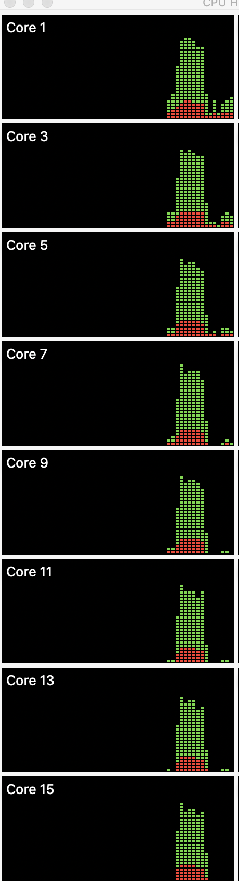
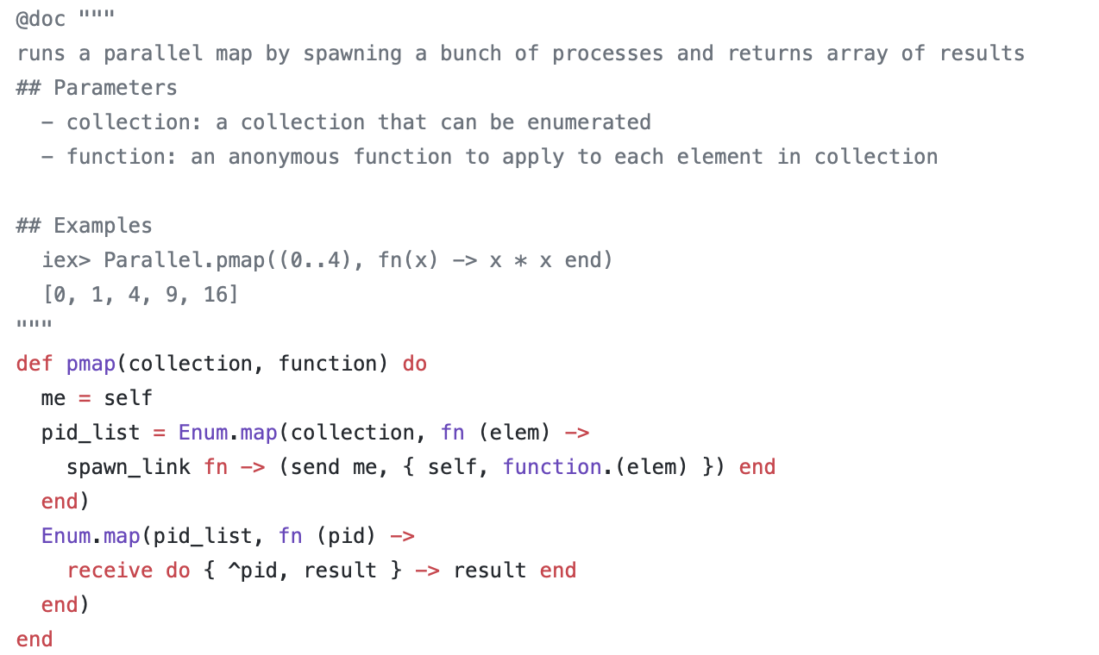
I have 8 cores on this laptop!
https://github.com/tomjoro/elixir_safe_practical

Slide 23
AWS Lambda
Good idea!
Isolated “functions”
As many as you want ($$)
Bad idea!
Functions are the wrong abstraction – I want processes with ability to stay running and have state. -> Step functions
But I need to push everything all the time
Step functions cost 10x more than lambda functions
$$$ money making machine

Slide 24
Lambda
Responding ends the flow, I can’t do anything after
I want to background analytics… I would have to make analytics calls for every single tiny event
Or push to SQS or something
Or use a database

Slide 25
Database is the Bottleneck
“none of this matters because the database is always the bottle neck”
yeah, if you are doing stateless serverless things
If you are having to store things to the database, just as a side-effect of using a stateless architecture
How about caches - https://research.google/pubs/pub48030/
Is ”stateless” the only way to scale? Why?
How about scaling through stateful? (see google research)
Sticky sessions? Websockets?
Only save to the database when you need a checkpoint
I believe the future is stateful

Slide 26
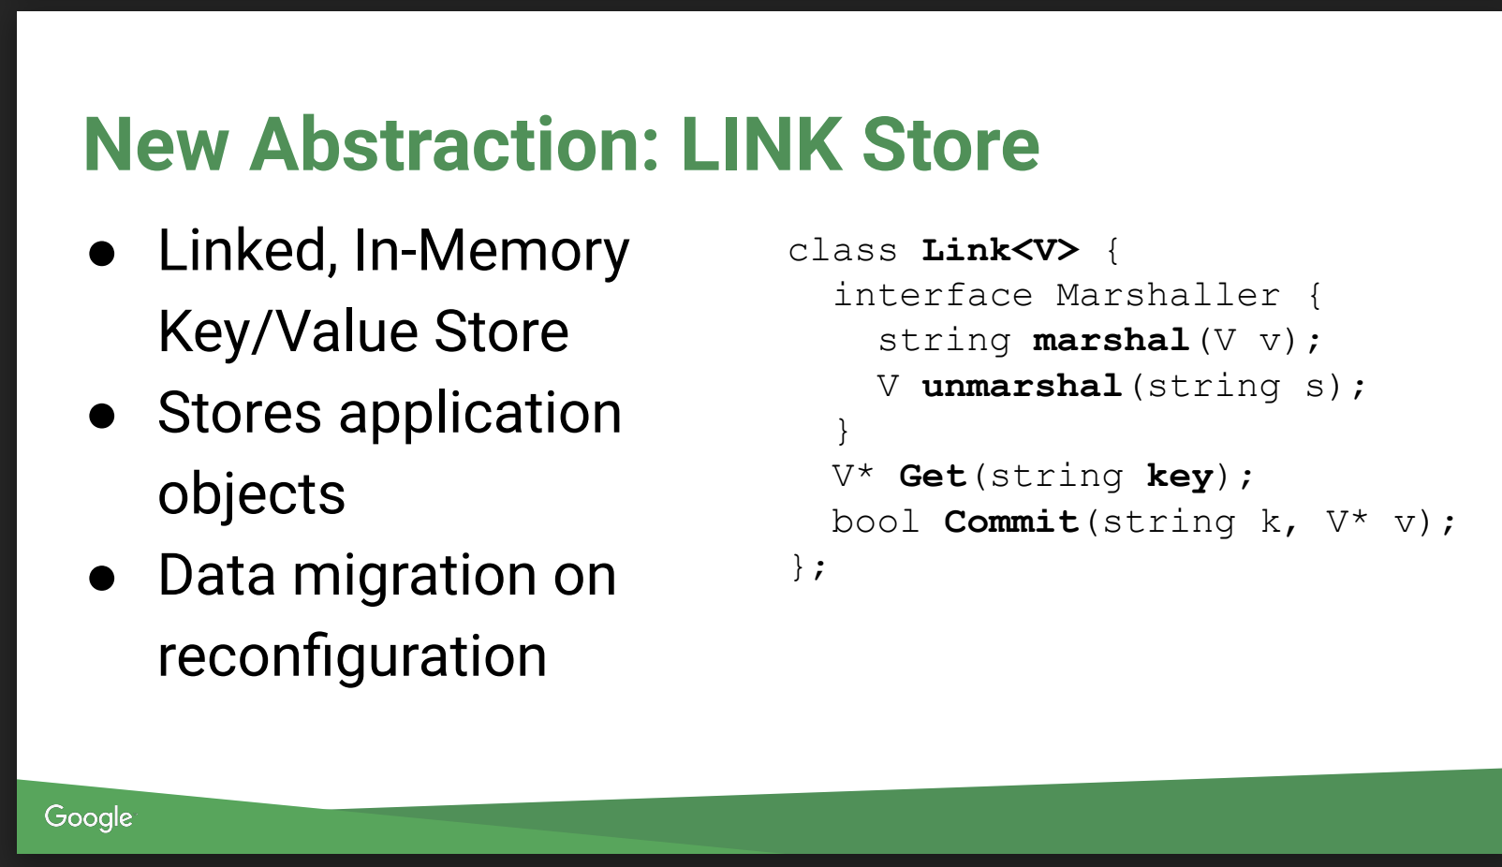
Meanwhile at Google
https://drive.google.com/file/d/1UpYuZm3JIQM4HNqXPGkSgWlyHMto6erm/view
Reinventing Erlang again

Slide 27


But I don’t need that kind of reliability in my program - it’s just a stupid webapp, and I don’t need scalability, and if I did need it I could just start lots of node.js instances and so if one failed that’s fine
My code doesn’t crash
I’m careful

Slide 28



You had one job…
A program that has errors not only can crash, it can leak data, have security problem and if it multithreaded it can put the entire system in to an uncertain state. Libraries and other peoples code may affect your code.
Notes:
*Btw our FP server has never gone down.

Slide 29
Practical

Slide 30
It can’t be all roses

Slide 31
What is Elixir not Good For
Image processing
Game engines (some)
High performance compute engines
In order to ensure safety, Elixir does not have indexed data structures so (very efficient) binary trees are the data structures

Slide 32
Unsafe parts of applications != don’t use Elixir
Elixir is great at interfacing and controlling
There are lots of techniques: ETS, for example
Just because 5% of your program is something that <drawing> is unsafe, doesn’t mean you can’t use Elixir
REST
Ports
Compiled in binary
Rust is a good way to do it because it is guaranteed not to leak. But be careful about threading (it needs it’s own thread).

Slide 33
Can we get back to coding please?
In a minute

Slide 34
I love it, but It can’t possibly work
Immutability – is it really going to create a new object every time? Garbage must pile up like crazy….
Overhead of copying even when I’m calling to processes on the same core?
Can I really create 10,000 process? And they schedule fairly?
Can I solve everything with Tuples, Maps, and Lists? And Recursion!
Can I live without Object Orientation? There are macros in Elixir… wtf?
I’m not convinced “Let it crash” is good… shouldn’t I handle the errors when they happen?
Notes:
It solves my problems

Slide 35
Code – try it yourself
https://github.com/tomjoro/elixir_safe_practical/code/part2
Parallel Map Reduce in Elixir
Lots of processes
Ruby vs Elixir Parser
Parsing and performance comparisons – garbage collection
Go vs Elixir for 2d
Worst case for Elixir, Good case for Go
Notes:
How do you kill a Java thread? Is it safe to do such a think? Impossible?

Slide 36
















Guaranteed
isolated
Multicore pre-emptive
(soft real-time)
Per-process Garbage
Simple – no OO
Not
dynamic
”Memory safe” + checked
Pre-emptive
scheduler
Virtual machine
Stop the world
Garbage
Complex –
OO + Functional
Lightweight/
Green threads
Dynamic
No-virtual machine
”Memory safe”
But threads can share memory
Clean up
yourself
Cooperative scheduling
Memory not checked
Notes:
Name that language Game! Prizes!
It’s not fair, because the garbage collector can run and you will get stopped.
What is Elixir good for. What is it not good for? Do I need a slide?
GO Does not have a virtual machine. It compiles bare.

Slide 37
Why “The impossible future”?
Why ”The impossible future”?
It’s too academic to be practical
You can’t hire or train Elixir developers
It’s unlike other languages – it’s impossible to have safety in a practical language
Here more at ElixirEU 2020 – “Taking Elixir Live at a Bank”

Slide 38
Why “The impossible future”?
Why ”The impossible future”?
It’s too academic to be practical
You can’t hire or train Elixir developers
It’s unlike other languages – it’s impossible to have safety in a practical language
Here more at ElixirEU 2020 – “Taking Elixir Live at a Bank”

Slide 39
Part 3
Phoenix and Phoenix Live View

Slide 40
Phoenix
”I’m looking at some Phoenix code. I don’t see any processes or spawning or any of that stuff. Is it really there?”
Yes:
Cowboy is create a new process for every web request that is received
Ecto uses Poolboy and a pool of process to talk to external resources
There are hundreds of processes running out of the box in Phoenix
You just normally are using a much higher abstraction.. ☺ called OTP…. Which is another topic

Slide 41
Practical Elixir
How do I debug?
It’s difficult because it is inherently asynchronous and concurrent
IO.puts
Iex.break
Test cases are great
Trace
:monitor

Slide 42
Code example
In the sample code there is “talented_live” which has 3 parts:
talented_live1 – setup
talented_live2 – adding live view
talented_live3 – doing something with live view
https://github.com/tomjoro/elixir_safe_practical/code/part3

